Slide 1
Project Management
Planning & Scheduling
--------------------------
ENGR 300
Dept. of Computer Science and Engineering
University of Bridgeport, CT 06601
EGNR 300

Slide 2
“Failing to plan is planning to fail” by J. Hinze, Construction Planning and Scheduling
Planning:
  “what” is going to be done, “how”, “where”, by “whom”, and “when”
  for effective monitoring and control of complex projects

Slide 3
“Its about time” by J. Hinze, Construction Planning and Scheduling
Scheduling:
  “what” will be done, and “who” will be working
    relative timing of tasks & time frames
  a concise description of the plan

Slide 4
“Once you plan your work, you must work your plan” by J. Hinze, Construction Planning and Scheduling
Planning and Scheduling occurs:
  AFTER you have decided how to do the work
    “The first idea is not always the best idea.”
Requires discipline to “work the plan”
  The act of development useful,
  But need to monitor and track
    only then, is a schedule an effective management tool
    as-built schedules

Slide 5
The Work Break Down Structure (WBS)
An organizational tool for complex projects
  A first step in creating a schedule
  Useful for defining the Scope of Work
    After decided how to do the work
Consists of:
  Goal statement for project
  Subdividing goal into smaller & smaller portions

Slide 6
WBS
Upper two or three levels
  require only general knowledge
  don’t get too detailed too quickly
The deeper you go, the more knowledge you need
Bottom level tasks:
    simple enough to estimate durations
    can assign crews
    each task has a natural sequence relative to other tasks

Slide 7
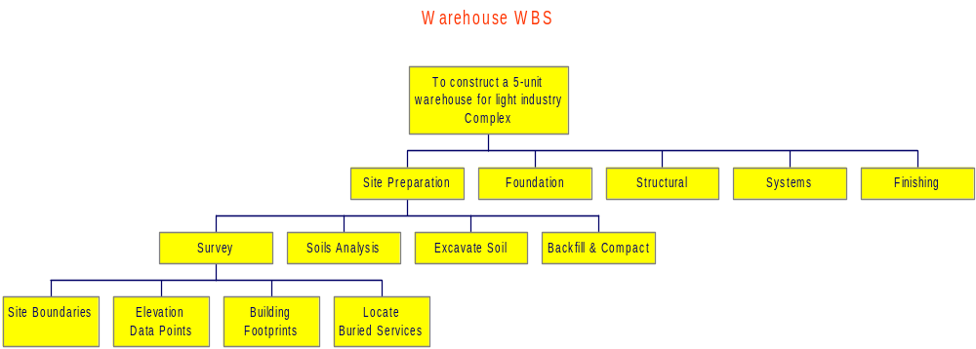
Example WBS
Could be used to define scope of
work for surveyor sub-contract

Slide 8
Order of Task Execution - Scheduling
Bar Charts (Gantt Charts)
  length of bar = task’s duration
  commonly used, require little training
  precedence relationships difficult to show
    precedence = the sequencing relationship between tasks
Notes:
“1917 Henry Gantt developed a method of relating a list of activities to a time scale by drawing a bar chart. Activities are represented as bars on the chart while across the top or bottom is a time line. For each activity, a bar is drawn from the activity’s starting time until its ending time. The gantt chart has been widely used in depicting schedules for construction projects. Its primary advantage is that its simple graphic representation allows one to grasp schedule information quickly and easily.” taken from J. Hinze, Construction Planning and Scheduling.

Slide 9
Order of Task Execution - Scheduling
Network Diagrams
  Critical Path Method (CPM)
    w/in construction - most important
  Program Evaluation and Review Technique (PERT)
    like a generalized CPM
    assumes that an activity’s duration cannot be precisely determined
      takes most likely, optimistic, pessimistic estimates
      computes an expected duration/activity and expected project duration

Slide 10
Critical Path Method (CPM)
Identifies those chains of activities (critical paths) that control how long a project will take.
Two variations:
  Activity-on-Arrow (AOA)
    activities are the arrows or lines
  Activity on Node (AON)
    also known as a Precedence Diagram
    activities are nodes connected together by lines

Slide 11
Some CPM Terms
Float = the amount of time an activity can be delayed without delaying the project
Critical = activities with no float; these activities can not be delayed w/o extending project duration
Contingency = include a time allowance to account for time slippage & other delays
Slippage = difference between actual and scheduled progress

Slide 12
Computer Scheduling
“Projects should be scheduled one byte at a time”
by J. Hinze, Construction Planning and Scheduling

Slide 13
Creating a Computerized Schedule
Primavera P3, SureTrak, CA-SuperProject, MSProject
Uses CPM for calculating project duration
Offer Gantt and Precedence views
  Gantt the default
  Activities can be viewed in other forms: activity and resource calendars, spreadsheets
Useful for
  updating and tracking
  sorting, filtering, resource leveling
Notes:
Sorting = grouping activities according to some common criteria
Filtering = creating mini-schedules covering specific portions of the work
Resource leveling = when project duration is fixed, smoothing out the utilization of recourses, like a particular trade or craft.

Slide 14
Creating a Computerized Schedule
Specify a base calendar
  calendar days vs. working and non-working days
  specialized activity and resource calendars
    tasks that cannot be performed on specific days
    days that resources are available
      (otherwise assumed that resources are available at all times on every working day)
Specify the project start or finish date

Slide 15
Creating a Computerized Schedule
Input activities from the WBS
  basic info needed: name, duration, predecessors, and successors
  if relevant: resources utilized plus associated costs
Collapsing the schedule
  consolidating subtasks within their summary tasks to view main project activities w/o cluttering the screen

Slide 16
Creating a Computerized Schedule
Expanding the schedule
  showing sub tasks w/in respective summary tasks
Link lines
  the line that connects the bars of linked tasks on the Gantt chart

Slide 17
Creating a Computerized Schedule
Linking
  creating relationships between activities
  finish-to-start, start-to-start, finish-to-finish, or start-to-finish
  can include lag or lead times
Network loop
  circular logic within a set of activities
  all loops must be eliminated for computations to be made

Slide 18
Creating a Computerized Schedule
Progress bar
  graphical representation of the % completion of an activity at a specific date
  shown adjacent to, or within, the activity bar
Summary task
  representing a general activity of construction
  duration calculated from sub-tasks
Create a baseline schedule
  original schedule created at the beginning
    actual progress is compared to

Slide 19
Getting CPM w/MSProject
After input of schedule
  choose Gantt view
  use GanttChart Wizard to calculate CPM
Can filter and show only CPM
  in drop-down menu:
    project ⇒ filtered for ⇒ critical
  to get back to full task list:
    project ⇒ filtered for ⇒ all

Slide 20
Example - Roof Structure
The following seven tasks are required for the erection of a building roof structure. Some of the tasks can be completed simultaneously; the overhang with sofit can be constructed while the deck is being installed.
1 Place & secure trusses, 2 days
2 Install roof deck, 7 days
3 Apply vapor barrier, 2 days
4 Apply roof cladding, 2 days
5 Construct roof overhang, 4 days
6 Install soffits, 4 days
7 Apply flashing, 6 days

